Slide 1
Demand Forecasting of Airline Passengers
Aishwarya Kulkarni

Slide 2
Introduction
Forecasted demand is a key input to MPC – Production Planning, MPS
Demand is influenced by economic conditions, competition, market trends, firm’s strategies (pricing, discount, advertising, design)
Demand is a time series
Characteristics of Demand: Pattern, Trend, Seasonality, Random Variation, Cycle

Slide 3
Forecasting Principles
1. Forecasts are usually wrong: Errors are inevitable and must be expected.
2. Every forecast should include an estimate of error.
3. Forecasts are more accurate for families or groups.
4. Forecasts are more accurate for nearer time periods.

Slide 4
Forecasting Methods
Exponential Smoothing
1.1 Simple Exponential Smoothing (SES)
1.2 Holt Winter’s Exponential Smoothing (HWES)
Autoregressive schemes
2.1 Moving Average (MA)
2.2 Autoregression (AR)
2.3 Autoregressive Moving Average (ARMA)
2.4 Autoregressive Integrated Moving Average (ARIMA)
2.5 Seasonal Autoregressive Integrated Moving-Average (SARIMA)
2.6 Seasonal Autoregressive Integrated Moving-Average with Exogenous Regressors (SARIMAX)
Vector Autoregressive schemes
3.1 Vector Autoregression (VAR)
3.2 Vector Autoregression Moving-Average (VARMA)
3.3 Vector Autoregression Moving-Average with Exogenous Regressors (VARMAX)

Slide 5
Forecasting Technique
Qualitative techniques
Quantitative techniques
Extrinsic (external):
Intrinsic (inernal):

Slide 6

Moving average (MA) technique
MA is of the most fundamental quantitative techqniues. It is characterized with a window size parameter.
Formula of MA with window size W:
Let the demand is given for period 1 to T, denoted by 𝐷1D1, ..., 𝐷𝑇DT. Forecasted demand for period T+1:

Slide 7
Exponential smoothing (ES) technique
In the moving average technique, a window parameter W is chosen. Then, weights for only the previous W observations are assigned. But the weight of the older data points is assumed to be zero.
Let 𝛼α be scalar where 0≤𝛼≤10≤α≤1. It is called smoothing constant of the ES scheme.
New forecast = (𝛼α)(latest demand) + (1-𝛼α)(Previous forecast)
This can be denoted as:
𝐷̂ 𝑇+1 = (𝛼) 𝐷𝑇 +(1−𝛼) 𝐷̂ 𝑇 ,D^T+1 = (α) DT +(1−α) D^T ,
where hat denotes forecasted value. 𝛼α is typically between 0 and 0.3.

Slide 8


Seasonality
Many products have a seasonal or periodic pattern. For example skis, bathing suits, Christmass tree lights. For some products, for example in restaurants, the priodic pattern is weekly. Electricity demand has an hourly pattern.
Seasonal Index
It measures how much the demand during that season will be above or below the average.

Slide 9
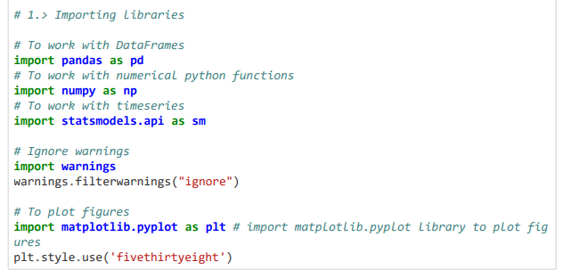
Importing Libraries

Slide 10
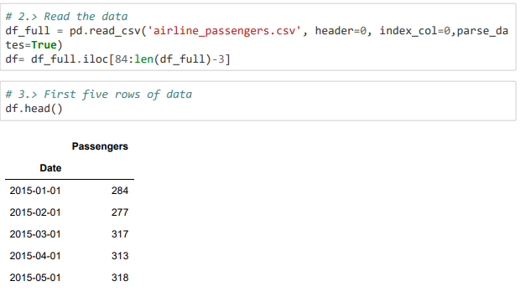
Reading Data - airline_passengers.csv

Slide 11
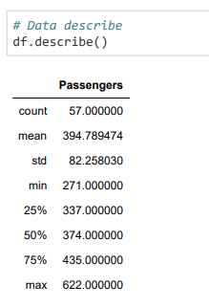
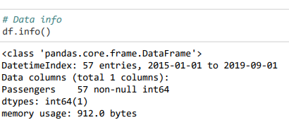
Data Description and Information

Slide 12
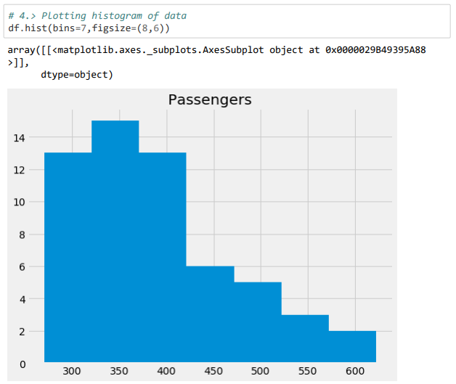
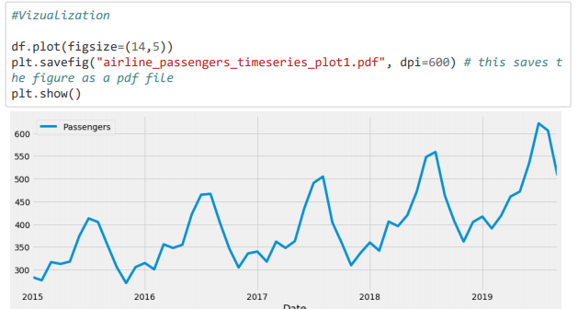
Vizualizing the Data

Slide 13
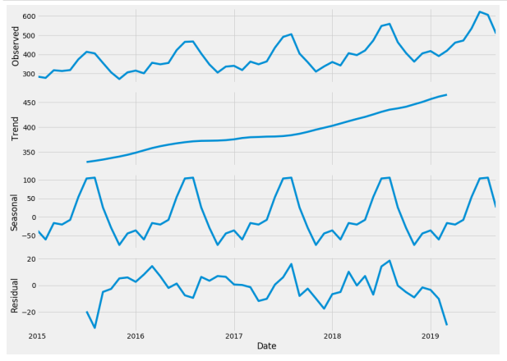
Time Series Decomposition

Slide 14
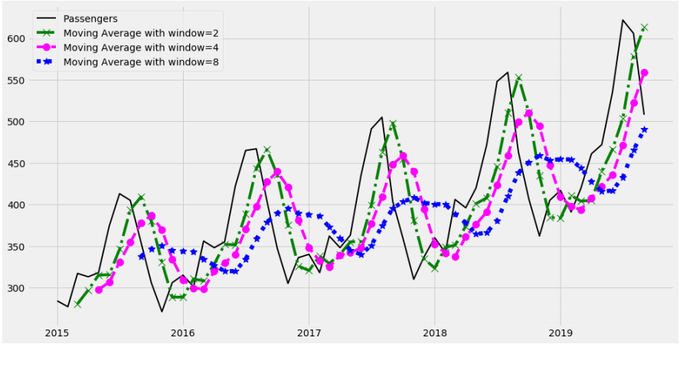
Moving Average Technique

Slide 15
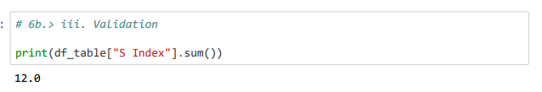
Deseasonalization Process
Seasonal Index
Validation

Slide 16
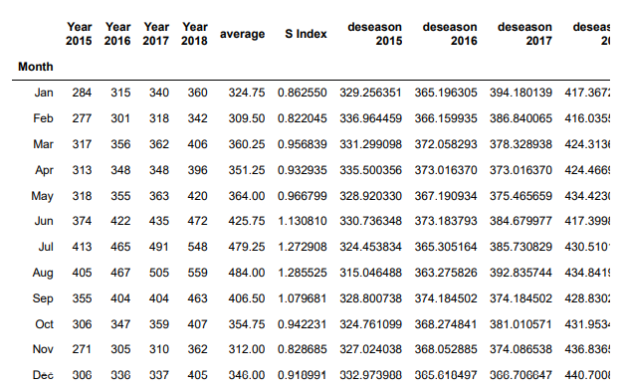
Decomposing the data into train and test
Decomposing the data into train and test

Slide 17
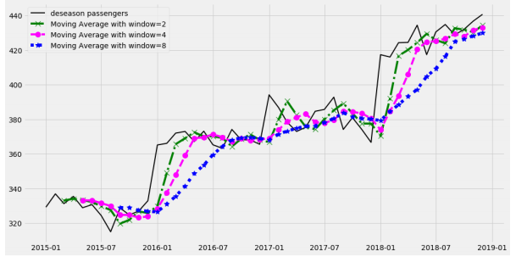
Training the MA Model

Slide 18


MAD (mean absolute deviation)
According to the MAD scoring, we then choose the window size 2

Slide 19
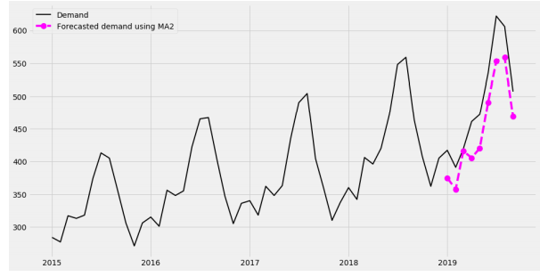
Testing the MA Model

Slide 20
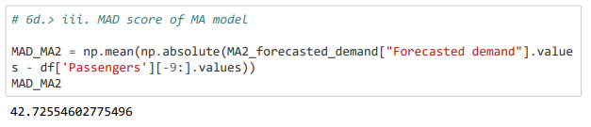
MAD Score for Moving Average

Slide 21
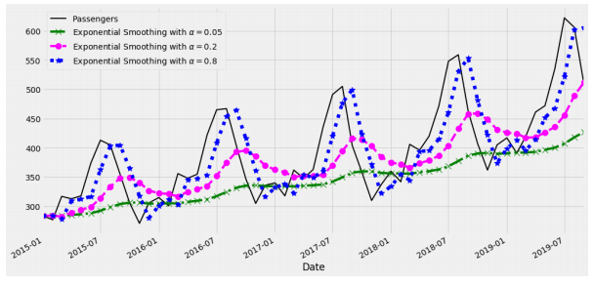
Exponential Smoothing Technique

Slide 22
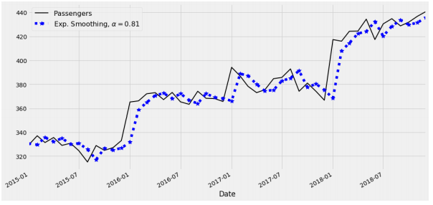
Training the ES Model

Slide 23
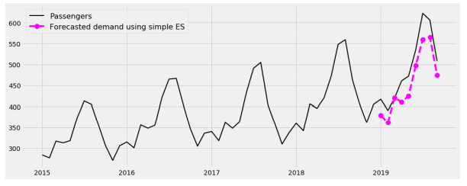
Testing the ES Model

Slide 24
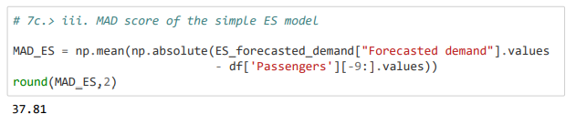
MAD Score for Exponential Smoothing

Slide 25
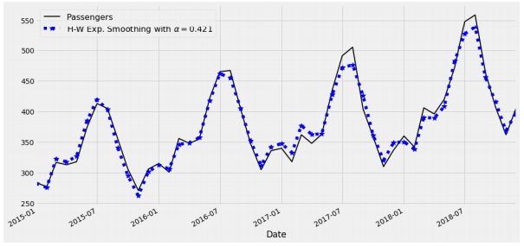
Holt-Winters Exponential Smoothing Technique This is a revised and sofistichated variant of simple ES. The main advantage is that it works on seasonal data. So, there is no need to deasonalize the data in this mehtod. Training the HW Model

Slide 26
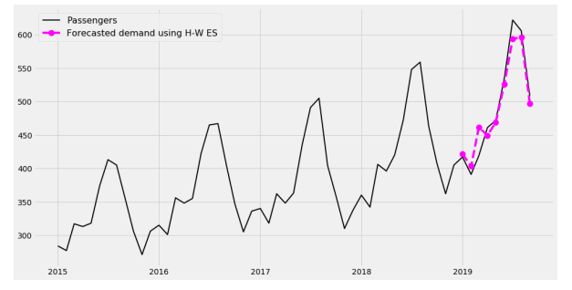
Testing the HW Model

Slide 27
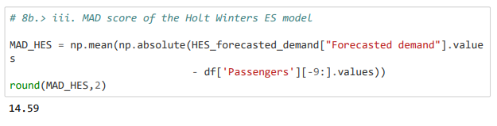
MAD Score for Holt-Winters Exponential Smoothing Model

Slide 28
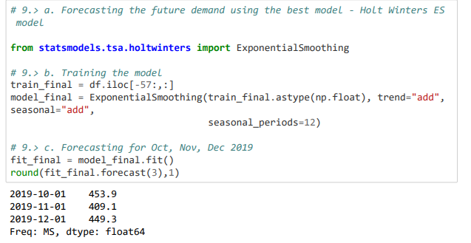
Forecasting the future demand using the best model

